Slide 1
Characteristics of Software &
Software Engineering

Slide 2
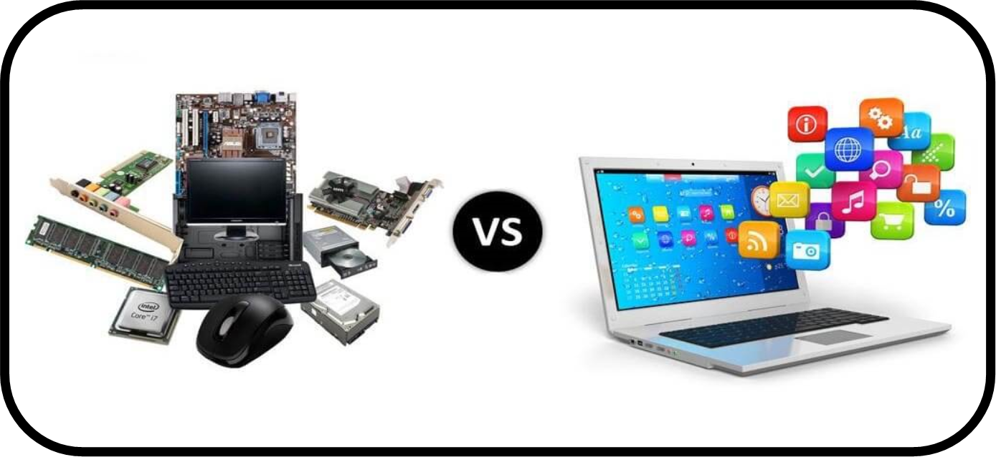
1. Software is engineered, not constructed.

Slide 3
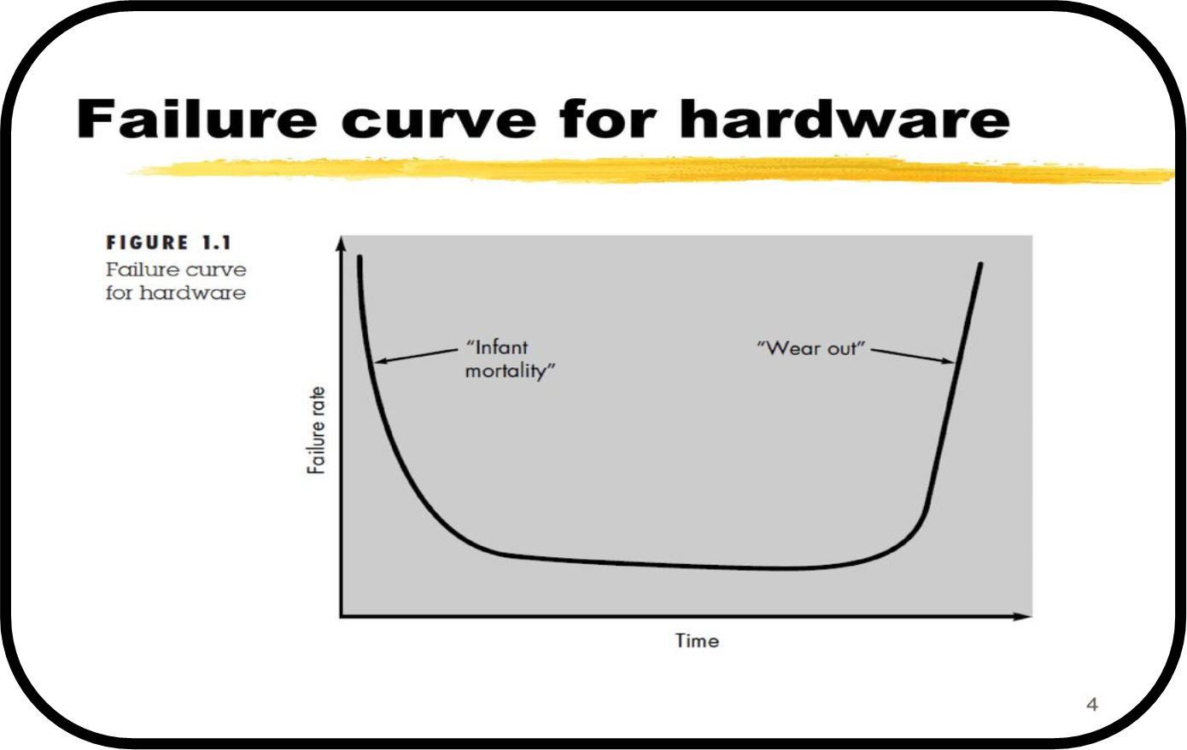
2. Software does not wear out but it deteriorates.

Slide 4
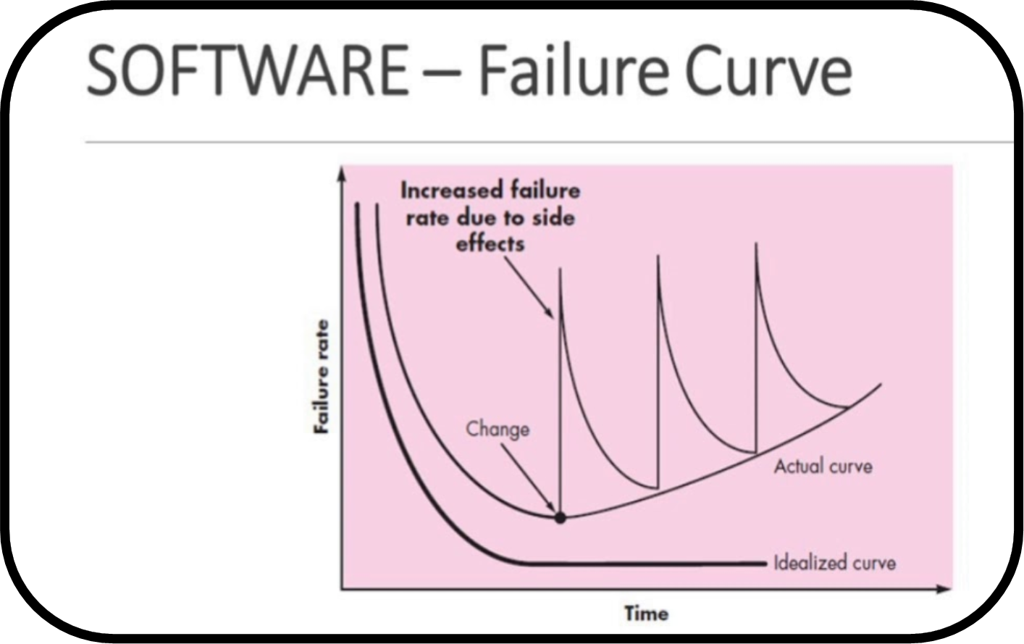
2. Software does not wear out but it deteriorates.

Slide 5


3. “Although industry is moving toward component based development, most software continues to be custom built.”

Slide 6
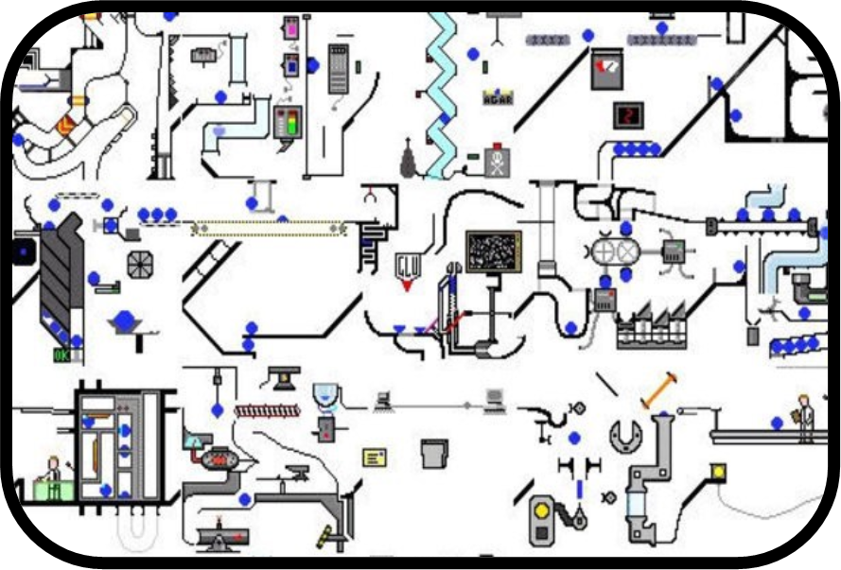
4. “Software is complex”.
“Software is an abstraction of real life”.

Slide 7
Why software engineering
Organized, systematic, and controlled software development
Software engineering is concerned with theories, methods and tools for professional software development
Customer wants low cost and short time for software development

Slide 8
Understanding of Software Engineering’s definition
Software engineering is an engineering discipline which is concerned with all aspects of software production.
IEEE [IEE93]:
Software Engineering: (1) The application of systematic, disciplined, quantifiable approach to the development, operation, and maintenance of software; that is, the application of engineering to software. (2) The study of approaches as in (1).

Slide 9
4. Basic Concepts
Software itself
Software Development life cycle
System Development life cycle
Computer Aided Software Engineering
Software Project Management
Software Process
Software Quality Assurance
Software Configuration Management
Software Maintenance

Slide 10
Thank You.

